Slide 1

National University of Computer and Emerging Sciences
Generative Adversarial Networks
AI-5004 Adv. Topics in Generative AI
Dr. Muhammad Nouman Noor
Department of Artificial Intelligence and Data Science

Slide 2
Goals
Today’s Lecture
RealNVP
Generative Adversarial Networks
GAN loss functions
Similarity Measures

Slide 3
Review of Previous Lecture

Slide 4
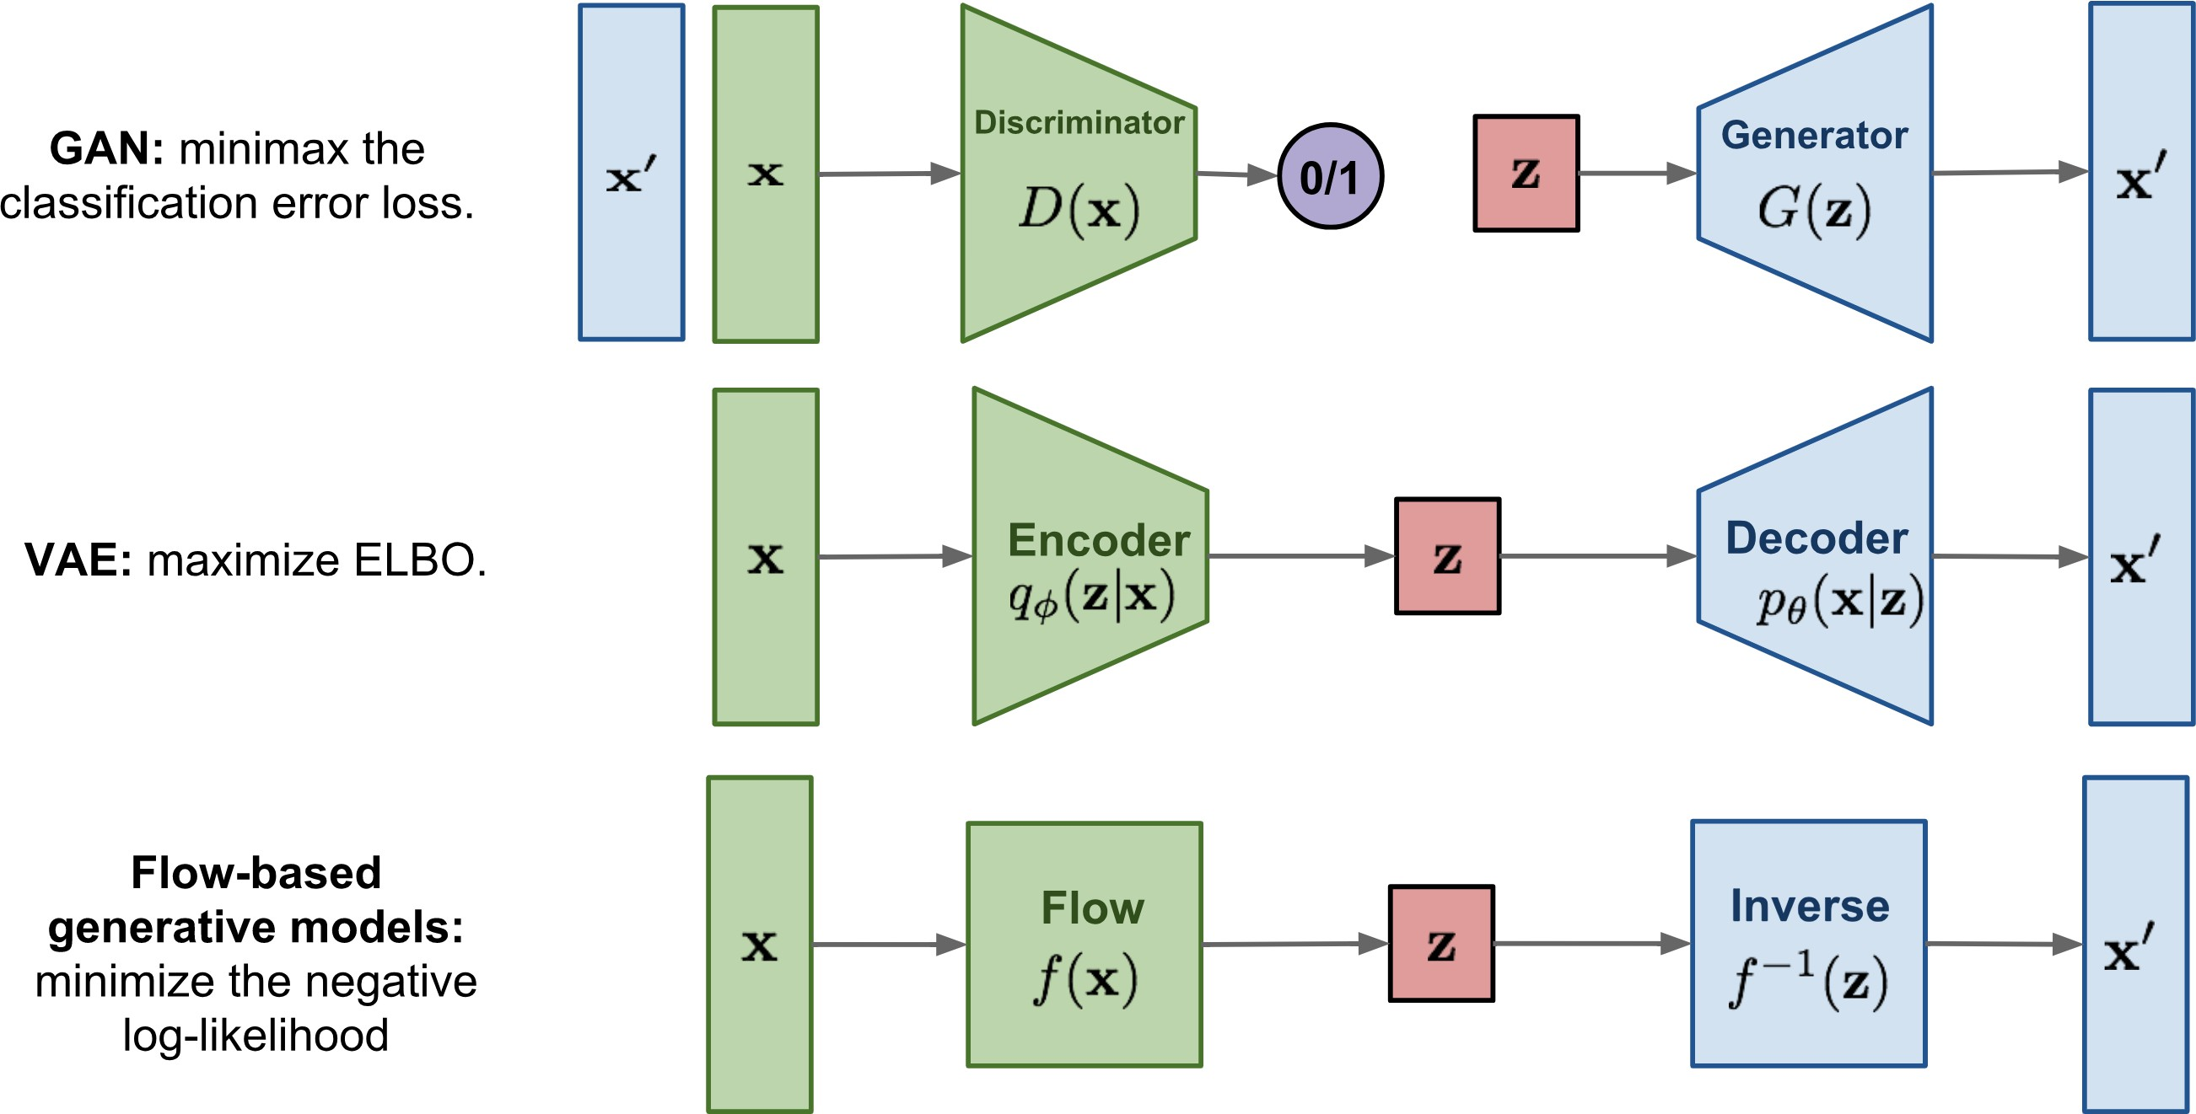
Types of Generative Models
Lilian Weng, "Flow-based Deep Generative Models," blog post, 2018.

Slide 5
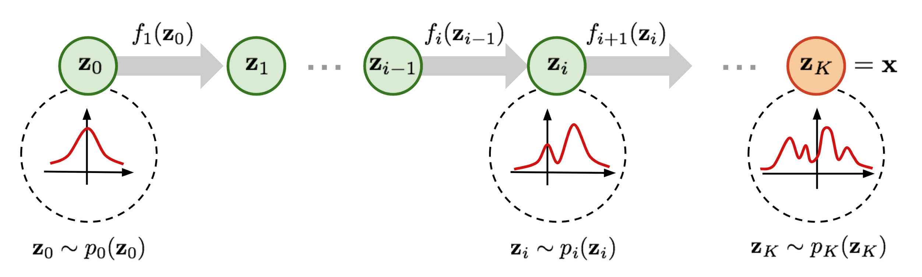
What is Normalizing Flows?

Slide 6
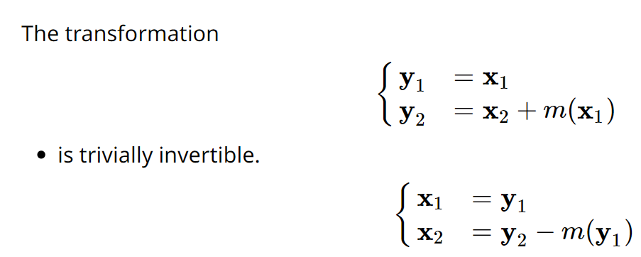
NICE - Additive coupling layers

Slide 7
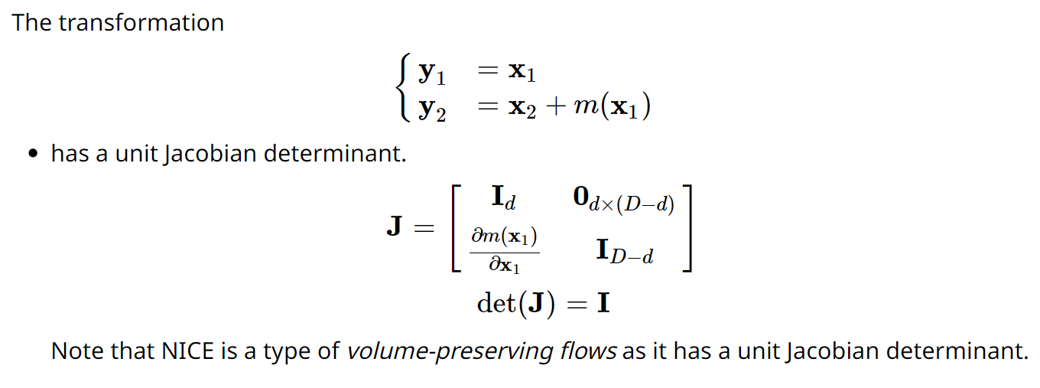
NICE - Additive coupling layers

Slide 8
Today’s Lecture

Slide 9
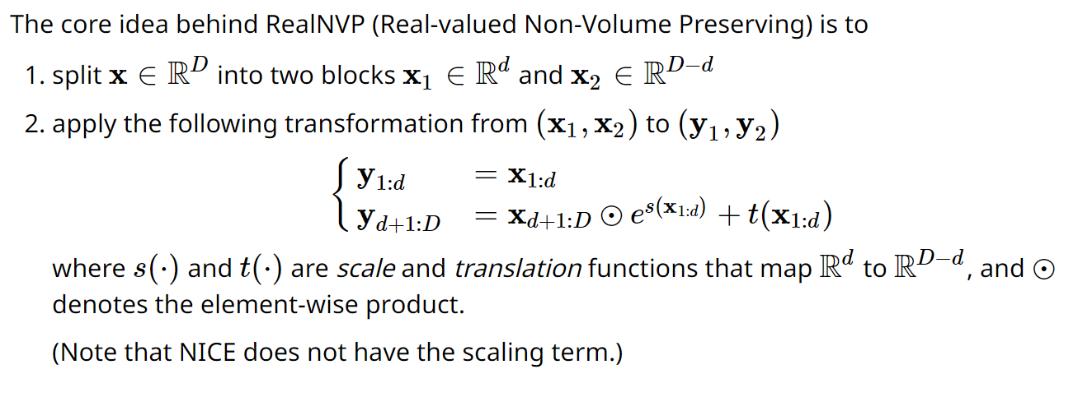
RealNVP: Real-valued Non-Volume Preserving flows

Slide 10
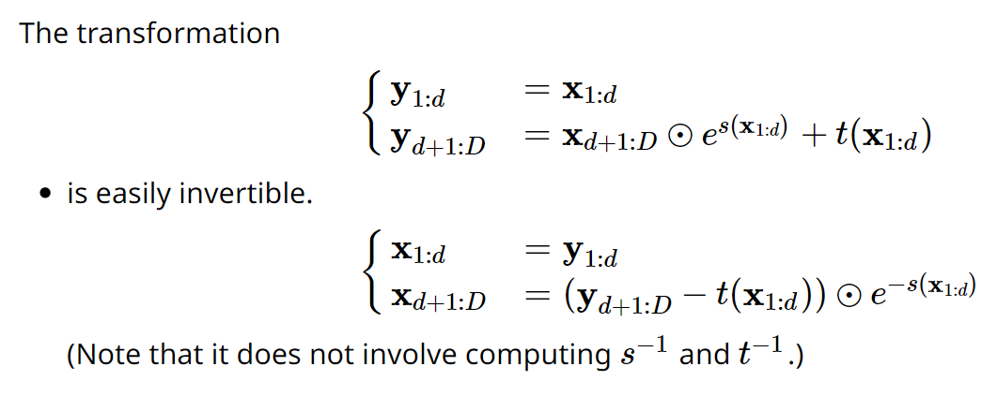
RealNVP - Affine coupling layers

Slide 11
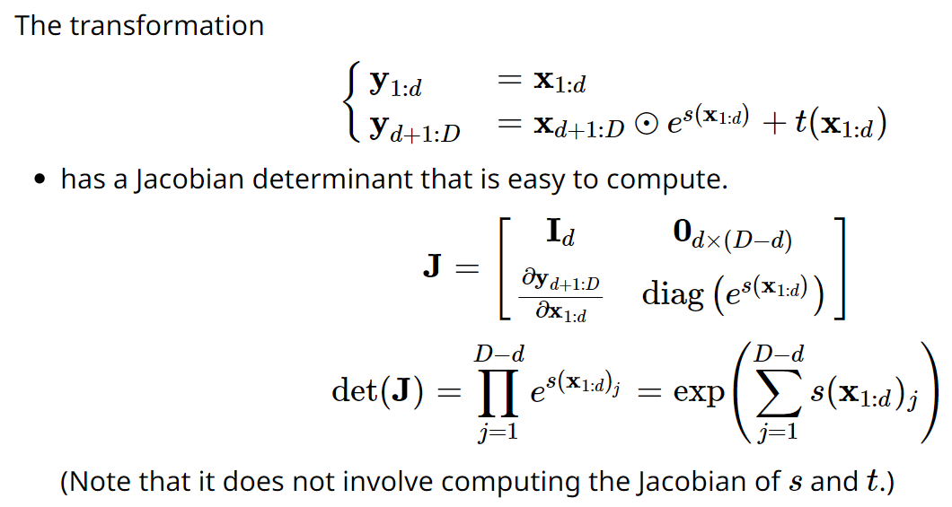
RealNVP - Affine coupling layers

Slide 12
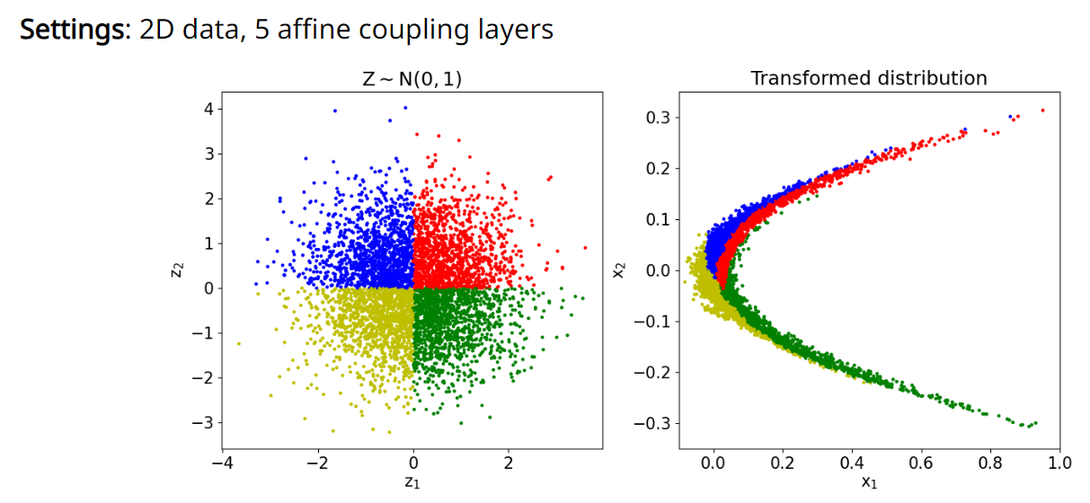
RealNVP - Experiments on toy data

Slide 13
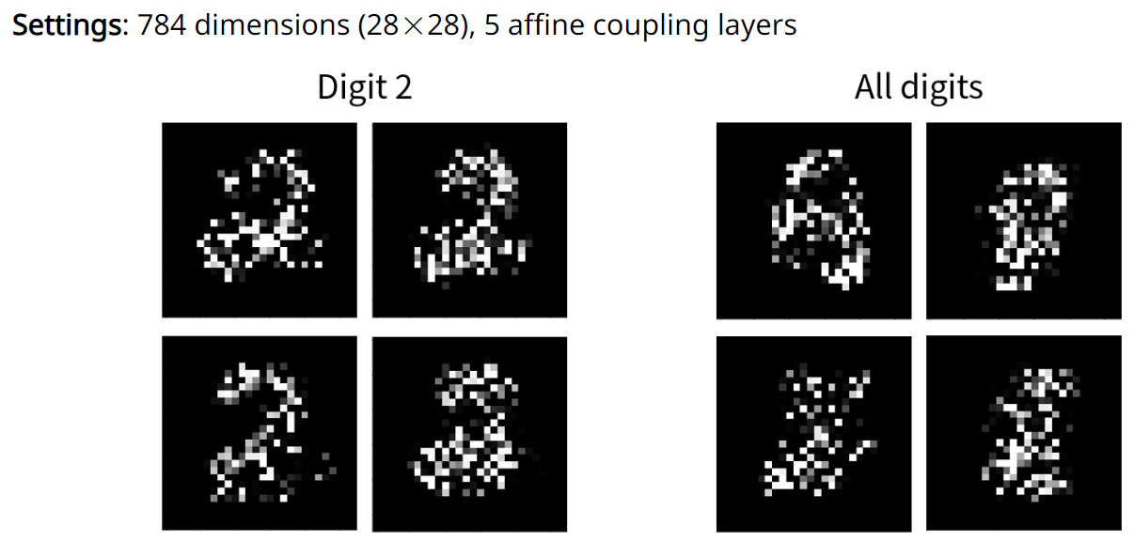
RealNVP - Experiments on MNIST

Slide 14
Generative Adversarial Networks

Slide 15

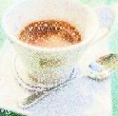
Autoencoder
As close as possible
NN
Encoder
NN
Decoder
Latent
Randomly generate a vector as code
NN
Decoder
Latent
Image ?

Slide 16
Common Problems with VAEs
Blurriness in Generated Samples:
Produces blurrier and less sharp images than the original data samples.
Nature of VAEs using the reconstruction loss (average out the variations).
Latent Space Regularization
Enforce a regularization on the latent space to ensure it follows a specific distribution (usually a Gaussian distribution).
Distribution of the data may not be approximated by the chosen prior well.
Prevent the VAE from capturing more complex distributions present in the data.
Balancing Act
Trade-off between the reconstruction loss and the KL divergence
Too much weight on the reconstruction loss can lead to ignoring the latent space structure
Too much weight on the KL divergence can lead to ignoring the data's details.

Slide 17
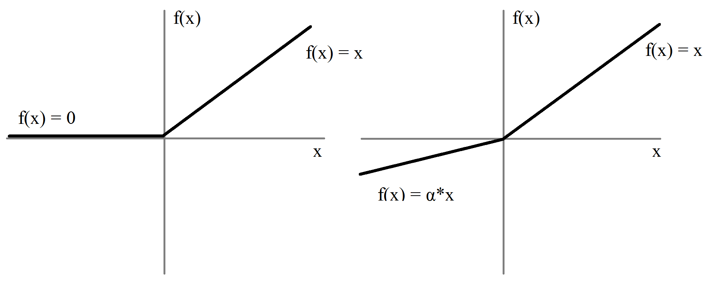
ReLU vs. Leaky ReLU (LReLU)
ReLU
LReLU

Slide 18
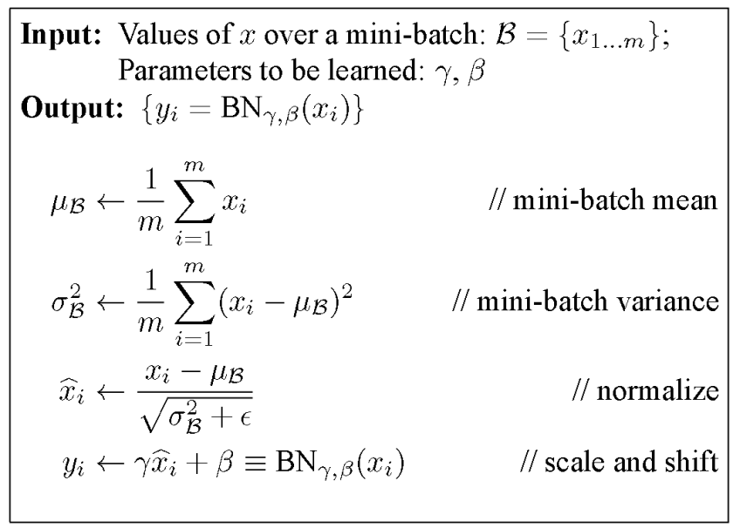
Batch Normalization (BN)
Saturation area
Zero gradient
https://towardsdatascience.com/batch-normalization-in-neural-networks-1ac91516821c

Slide 19






Transposed Convolution (Deconvolution)
Stride=1
Pad=Valid
Stride=2
Pad=Valid
Stride=2
Pad=Same
Output
Conv
Input
Output
Deconv
Input
https://github.com/vdumoulin/conv_arithmetic

Slide 20
Generative Adversarial Network (GAN)
GAN was first introduced by Ian Goodfellow et al in 2014
Cab be used in generating images, videos, text, some simple conversation.
Note, image processing is easy (even animals can do it), NLP is hard (only human can do it).
This co-evolution approach might have far-reaching implications. Bengio: this may hold the key to making computers a lot more intelligent.

Slide 21
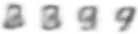
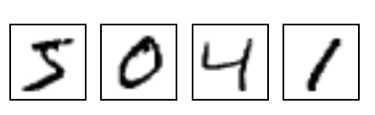
GAN – Learn a discriminator
Generator
Randomly sample a vector
0
0
0
0
Something like Decoder in VAE
Real images
Sampled from DB:
1
1
1
1
image
Discriminator
(real or fake)
1/0

Slide 22
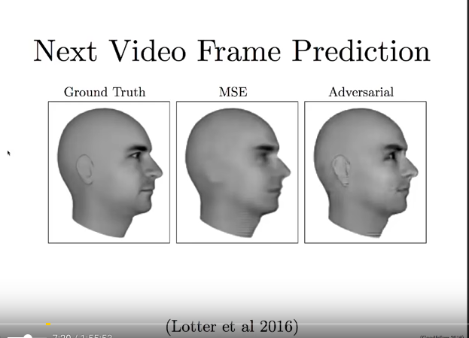
Next few images from Goodfellow lecture
Traditional mean-squared
Error, averaged, blurry

Slide 23
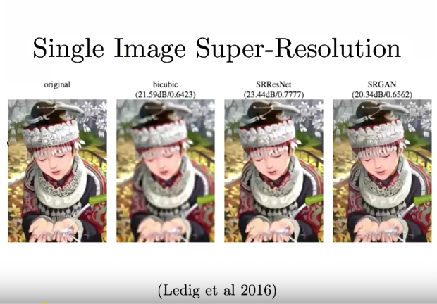

Slide 24
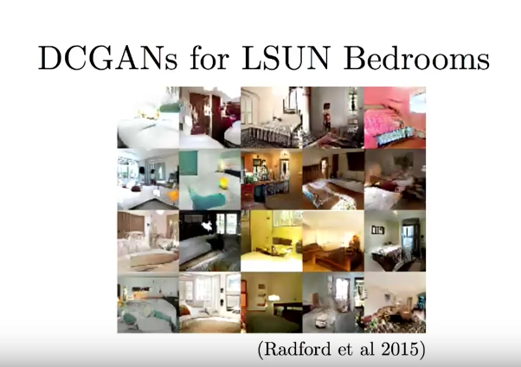

Slide 25
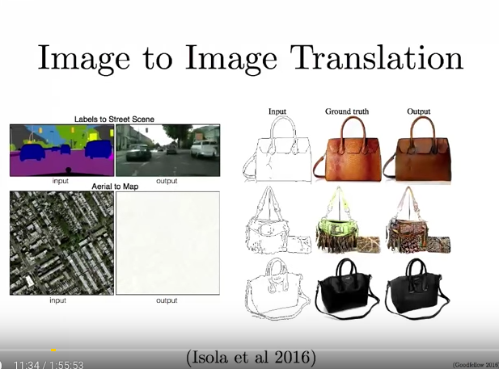

Slide 26
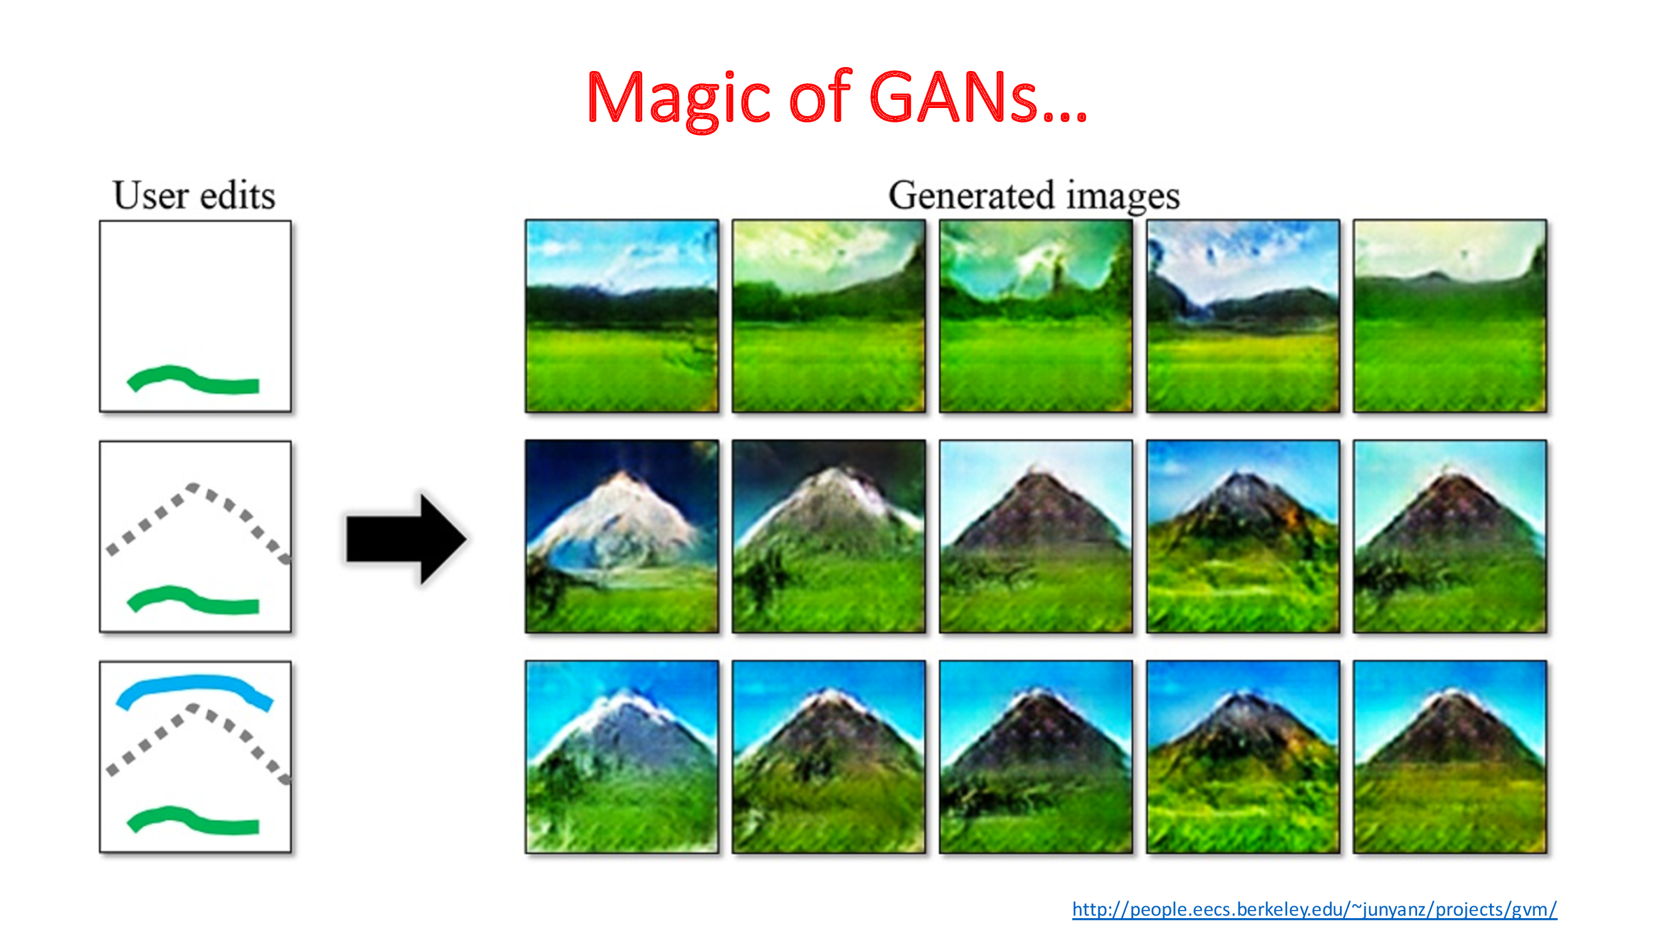

Slide 27
Generative Adversarial Network
GANs perform unsupervised learning tasks in machine learning.
It consists of two models that automatically discover and learn the patterns in input data:
Generator and Discriminator
They compete with each other to capture, and replicate the variations within a dataset.
GANs can be used to generate new examples that are similar to the original training dataset.

Slide 28
Generative Adversarial Network
Generator:
A Generator in GANs is a neural network that creates fake data to be trained on the discriminator.
It learns to generate probable data.
The generated examples/instances become negative training examples for the discriminator.
It takes a fixed-length random vector carrying noise as input and generates a sample.

Slide 29
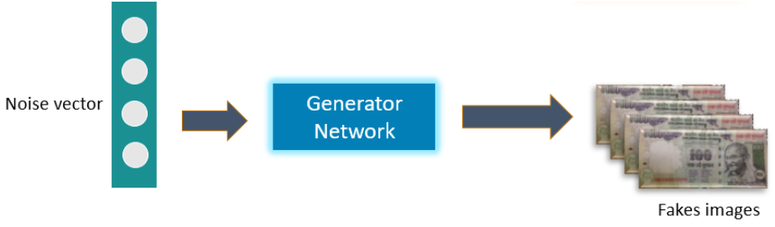
Generative Adversarial Network
The main aim of the Generator is to make the discriminator classify its output as real.
This can happen when the generator generates realistic images.

Slide 30
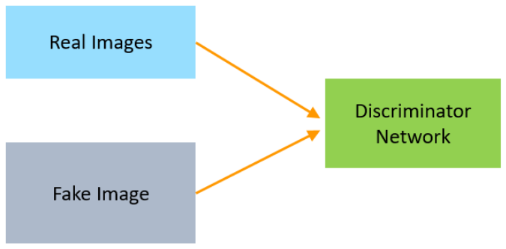
Generative Adversarial Network
Discriminator
The Discriminator is a neural network that identifies real data from the fake data created by the Generator.
The discriminator's training data comes from different two sources:
The real data instances
The fake data instances

Slide 31
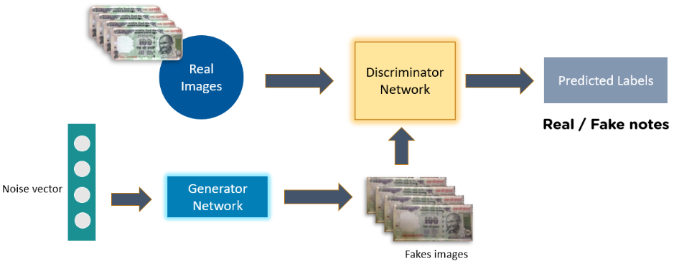
Generative Adversarial Network
Complete GAN Network

Slide 32
Random Input
In its most basic form, a GAN takes random noise as its input.
The generator then transforms this noise into a meaningful output.
By introducing noise, we can get the GAN to produce a wide variety of data.

Slide 33
GAN Training
Because a GAN contains two separately trained networks, its training algorithm must address two complications:
GANs must switch two different kinds of training (generator and discriminator).
GAN convergence is hard to identify.
Alternating Training
The discriminator trains for one or more epochs.
The generator trains for one or more epochs.
Repeat steps 1 and 2 to continue to train the generator and discriminator networks.

Slide 34
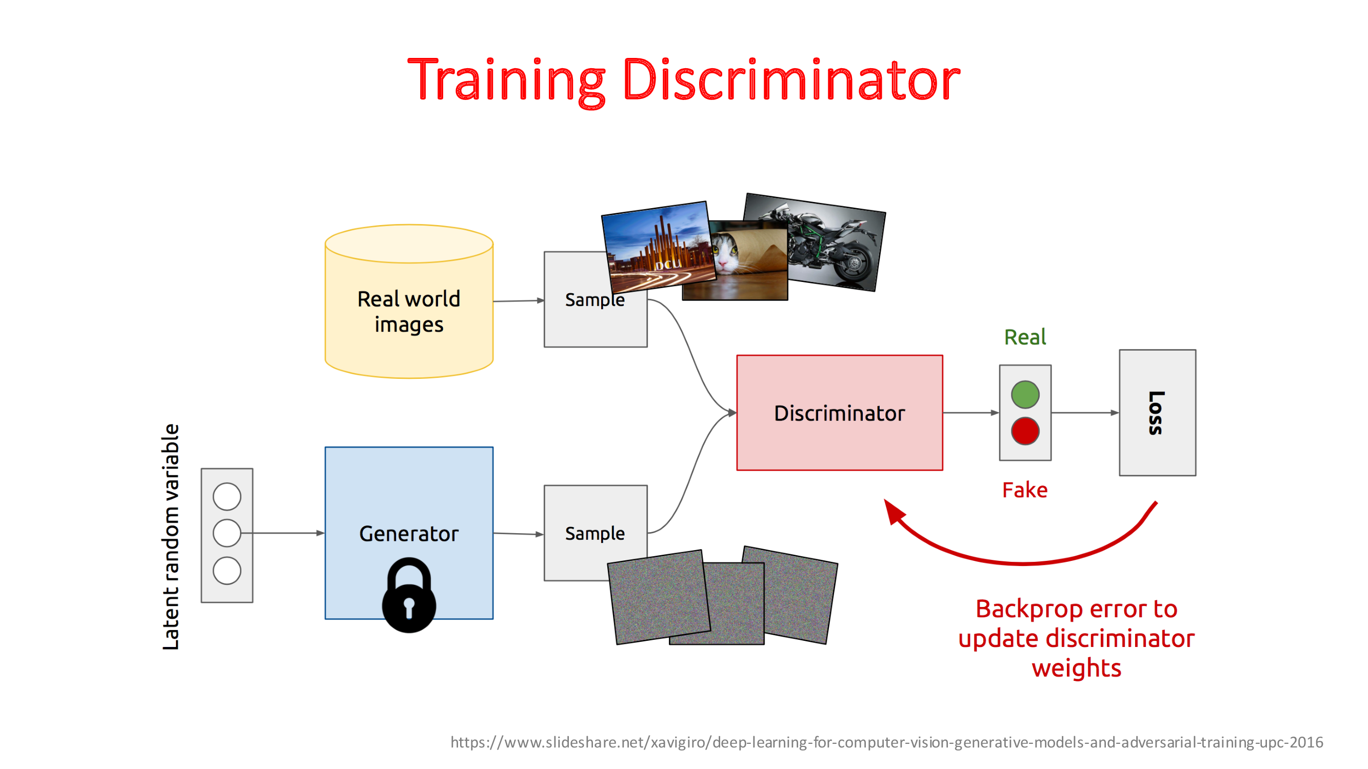

Slide 35
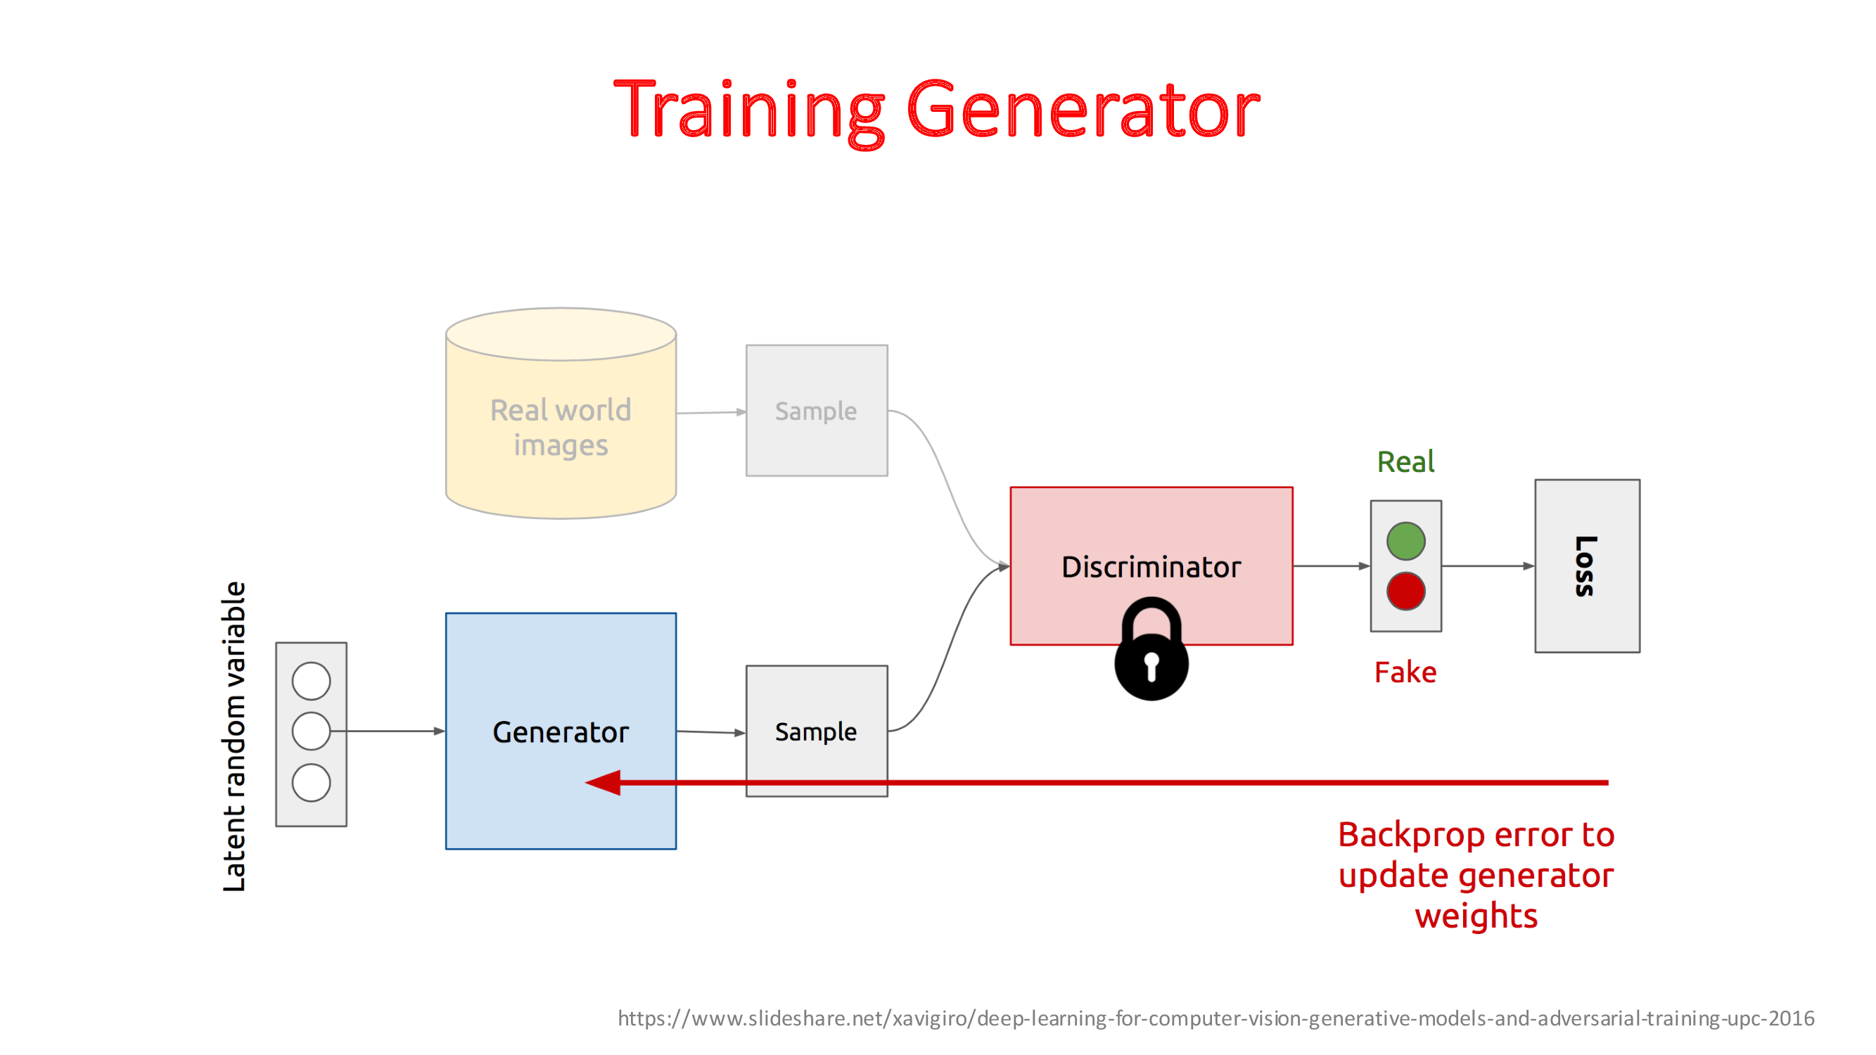

Slide 36
Generative Adversarial Network
Loss Functions
GANs generate the probability distribution of a particular data.
Loss functions measures distance between the distribution of the data generated by the GAN and the distribution of the real data.
Active research area
Many approaches have been proposed.
Two common GAN loss functions:
Minimax loss
Wasserstein loss

Slide 37
Loss Functions
Minimax Loss

Slide 38
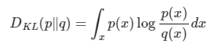
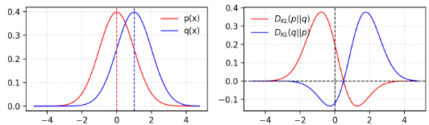
Similarity between two Distributions
KL (Kullback–Leibler) divergence:
Measures how one probability distribution diverges from a second expected probability distribution.
KL divergence is asymmetric.
If P(x)~0 and q(x) is non-zero,
then q’s effect is disregarded.
Problem to measure the similarity
between two equally important
distributions.

Slide 39
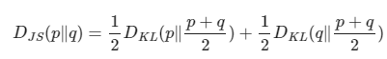
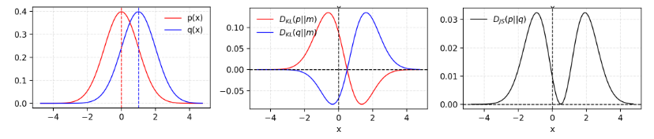
Similarity between two Distributions
Jensen–Shannon Divergence:
Also measures similarity between two probability distributions, bounded by [0,1]
JS divergence is symmetric and more smooth.

Slide 40
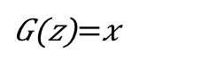
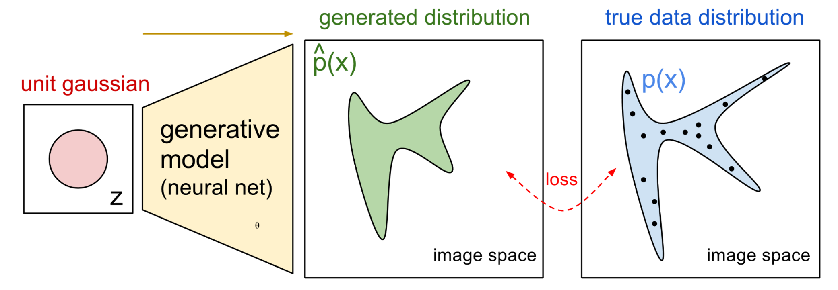
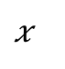
NN for P_{G}(x; θ)
P_{G}(x,θ)
P_{data}(x)
G
θ
Prior
distribution
of z
Smaller
dimension
Larger
dimension
How to compute the likelihood?
P_{G}(x) = Integration_{z} P_{prior}(z) I_{[G(z)=x]}dz
https://blog.openai.com/generative-models/

Slide 41
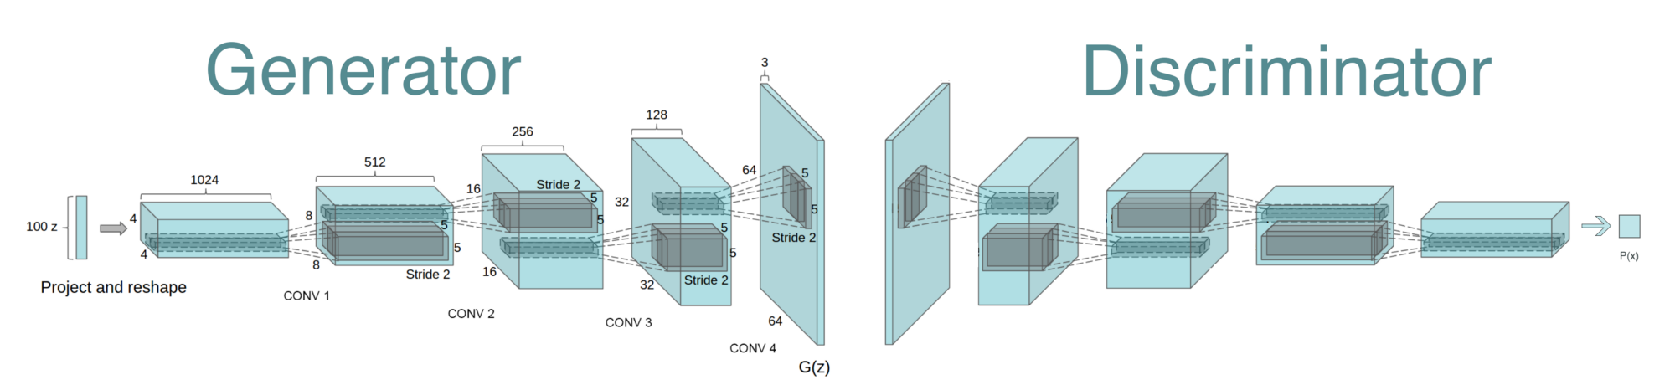
Generative Adversarial Network (GAN)
Reshape,
FC, sigmoid
FC, BN, ReLU
Reshape
Conv (kernel 5x5, stride 2)
BN, LReLU (slope 0.2)
Deconv, tanh/sigmoid
Deconv (kernel 5x5, stride 2)
BN, ReLU
https://github.com/PramodShenoy/GANerations

Slide 42
GAN on MNIST
Deconv
Tanh/Sigmoid
Conv, BN,
LReLU
Conv, BN,
LReLU
Reshape,
FC, BN,
LReLU
FC,
Sigmoid
FC, BN,
Reshape
Deconv
BN, ReLU
100
7x7x16
14x14x8
28x28x1
14x14x8
7x7x16
256
1
Generator
Discriminator

Slide 43
Thank You ☺

